Slide 1




Heap memory Manager
Project Developed at STMicroelectronics
under Supervision of Eng.Reda Maher
Presented by: Moaz Ragab

Slide 2

Overview
1-Introduction
2- Algorithm used
3-Methods Implemented
5-Tests
4-Problems

Slide 3


1-Introduction
-what is Heap ?
-why we use it ?
-what is syscall ?
-How to deal with heap ?

Slide 4

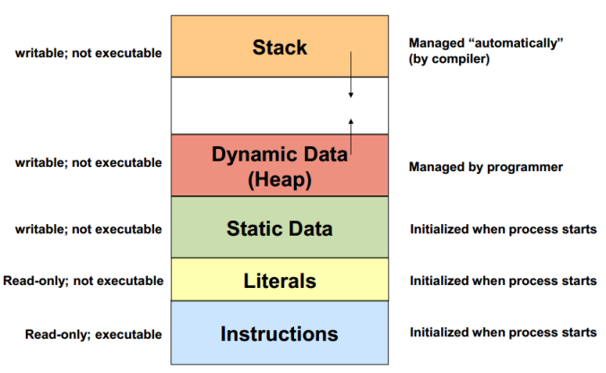
What is Heap and why it is important?
a heap refers to a region of a computer's memory after the end of BSS. Section that is allocated for dynamic memory allocation. It's a large pool of memory from which the program can request and use memory space dynamically during runtime. The heap is managed by the operating system's memory manager or allocator

Slide 5
what is syscall and how to deal with heap ?
A system call is a controlled entry point into the kernel, allowing a process to request that the kernel perform some action on the process’s behalf
A system call changes the processor state from user mode to kernel mode
The set of system calls is fixed. Each system call is identified by a unique number
We can find the start of heap with Sbrk(0) syscall before initializing Heap
Also we can Allocate more accessible space to use by the same syscall Sbrk

Slide 6

2-Algorithms
first fit
best fit?
OR

Slide 7
Best fit
In best fit we traverse the whole list to find the most suitable Block that we can use it
It may be better memory-wise but it has bad time complexity than first fit

Slide 8

first fit
In First-Fit, the operating system searches through the list of free blocks of memory, starting from the beginning of the list, until it finds a block that is large enough to accommodate the memory request from the process. Once a suitable block is found, it splits the block into two parts: the portion that will be allocated to the process, and the remaining free block.
And it reduces The time complexity in searching

Slide 9
3-Methods Implemented
void *heap_allocator(size_t size)
1
void heap_free(void *ptr)
2
void *heap_realloc(void *ptr, size_t size)
3
void *heap_calloc(size_t nmemb, size_t size)
4
void split(node *nodes, size_t size)
5
void merge(node *nodes);
6
void Init_Heap(size_t size);
7

Slide 10
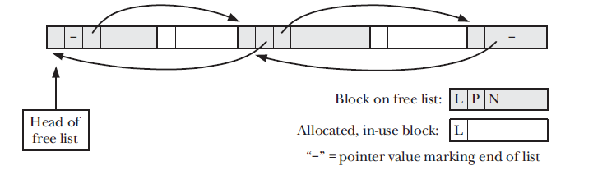
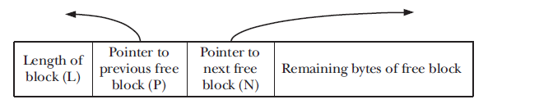
Data Structure
The list I created is a Data Structure that keeps tracking of the whole nodes even it is Free or used

Slide 11
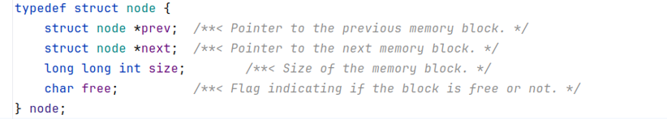
Meta Data

Slide 12
Init
This function initializes the heap with a specified size

Slide 13

Heap allocater
This function is the core of the memory allocation process. It searches for a suitable free block in the heap to allocate memory. If no suitable block is found, it allocates more memory from the system.

Slide 14
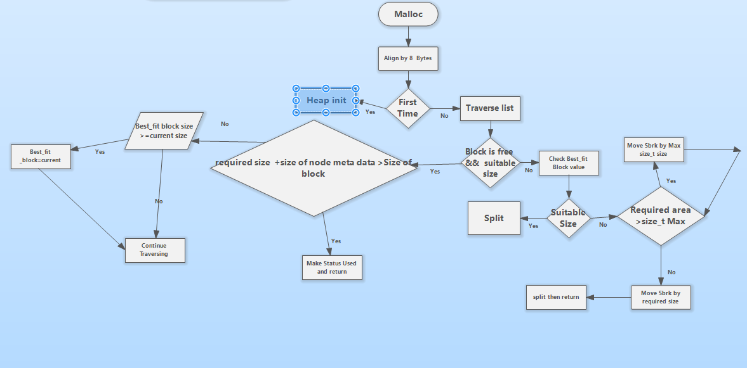
Heap allocator flow chart

Slide 15
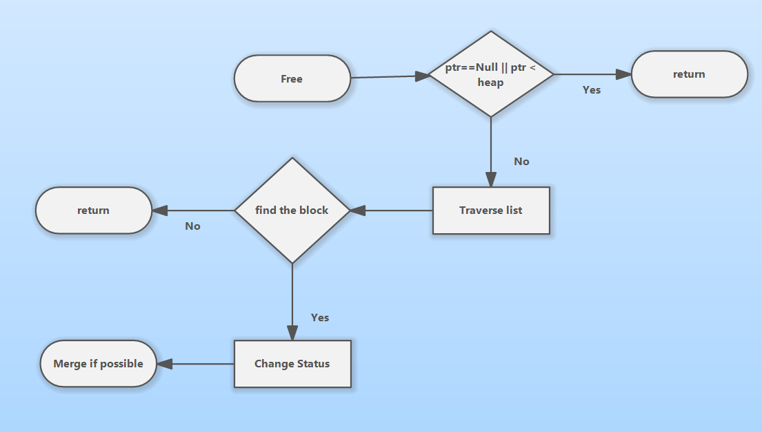
Heap Free
This function marks a memory block as free and merges adjacent free blocks.

Slide 16
Heap realloc
This function reallocates memory using the custom heap allocator.

Slide 17
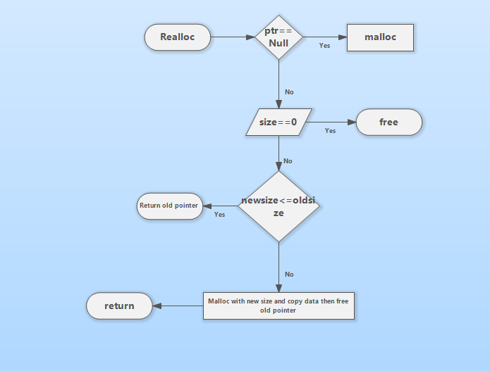
Heap realloc flow chart

Slide 18
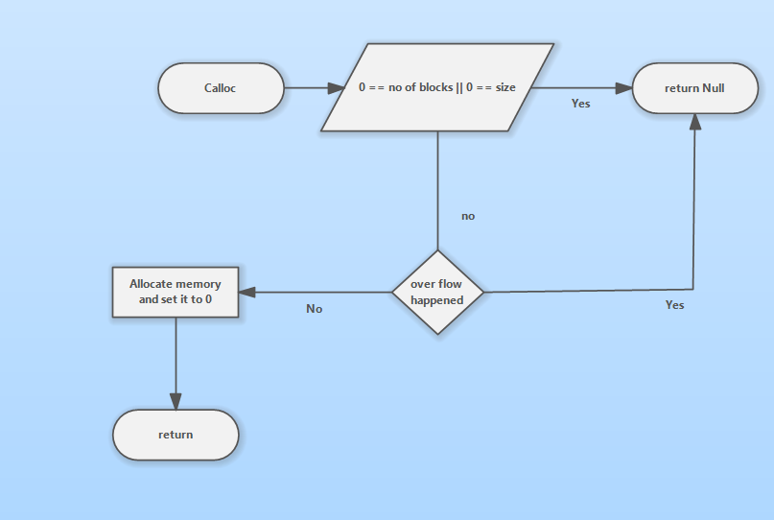
Heap Calloc
This function used to Store number of Blocks each of them specified with number of Bytes and initialized them with zero value

Slide 19
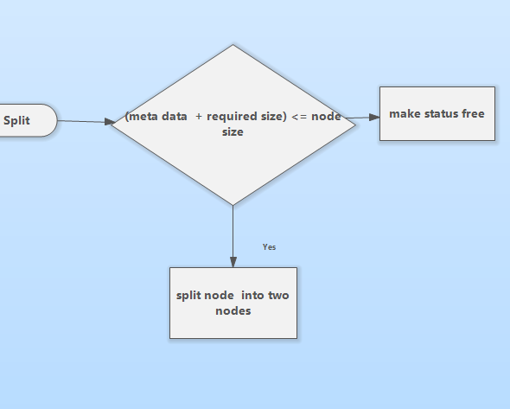
Split
This function splits a memory block into two blocks, one with the specified size and the other with the remaining size.

Slide 20
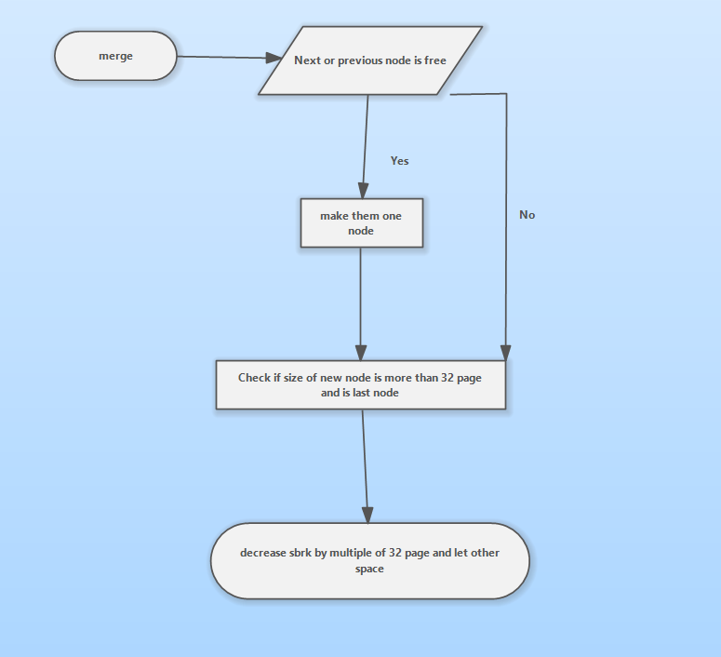
Merge
This function merges adjacent free memory blocks to prevent fragmentation.

Slide 21
4-Some problems happened to me
Ignoring metadata size while splitting
Accessing Place out of the boundary of Heap
Ignore Allocating of 0 size block if user asked
Over flow from wrong size estimation
User needs more than size_t Max size that sbrk takes

Slide 22
5-Tests
1-Sbrk_free
2- randomized test
3- 4- another randomized test
4- Manual test for corner cases
5-Linux utilites

Slide 23

OOPS

Slide 24
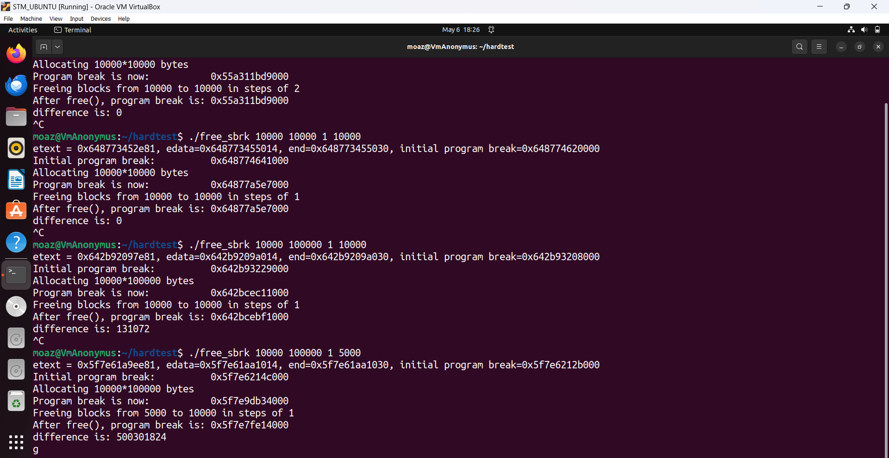
Sbrk_free test From The Linux Programming interface REFERENCE

Slide 25
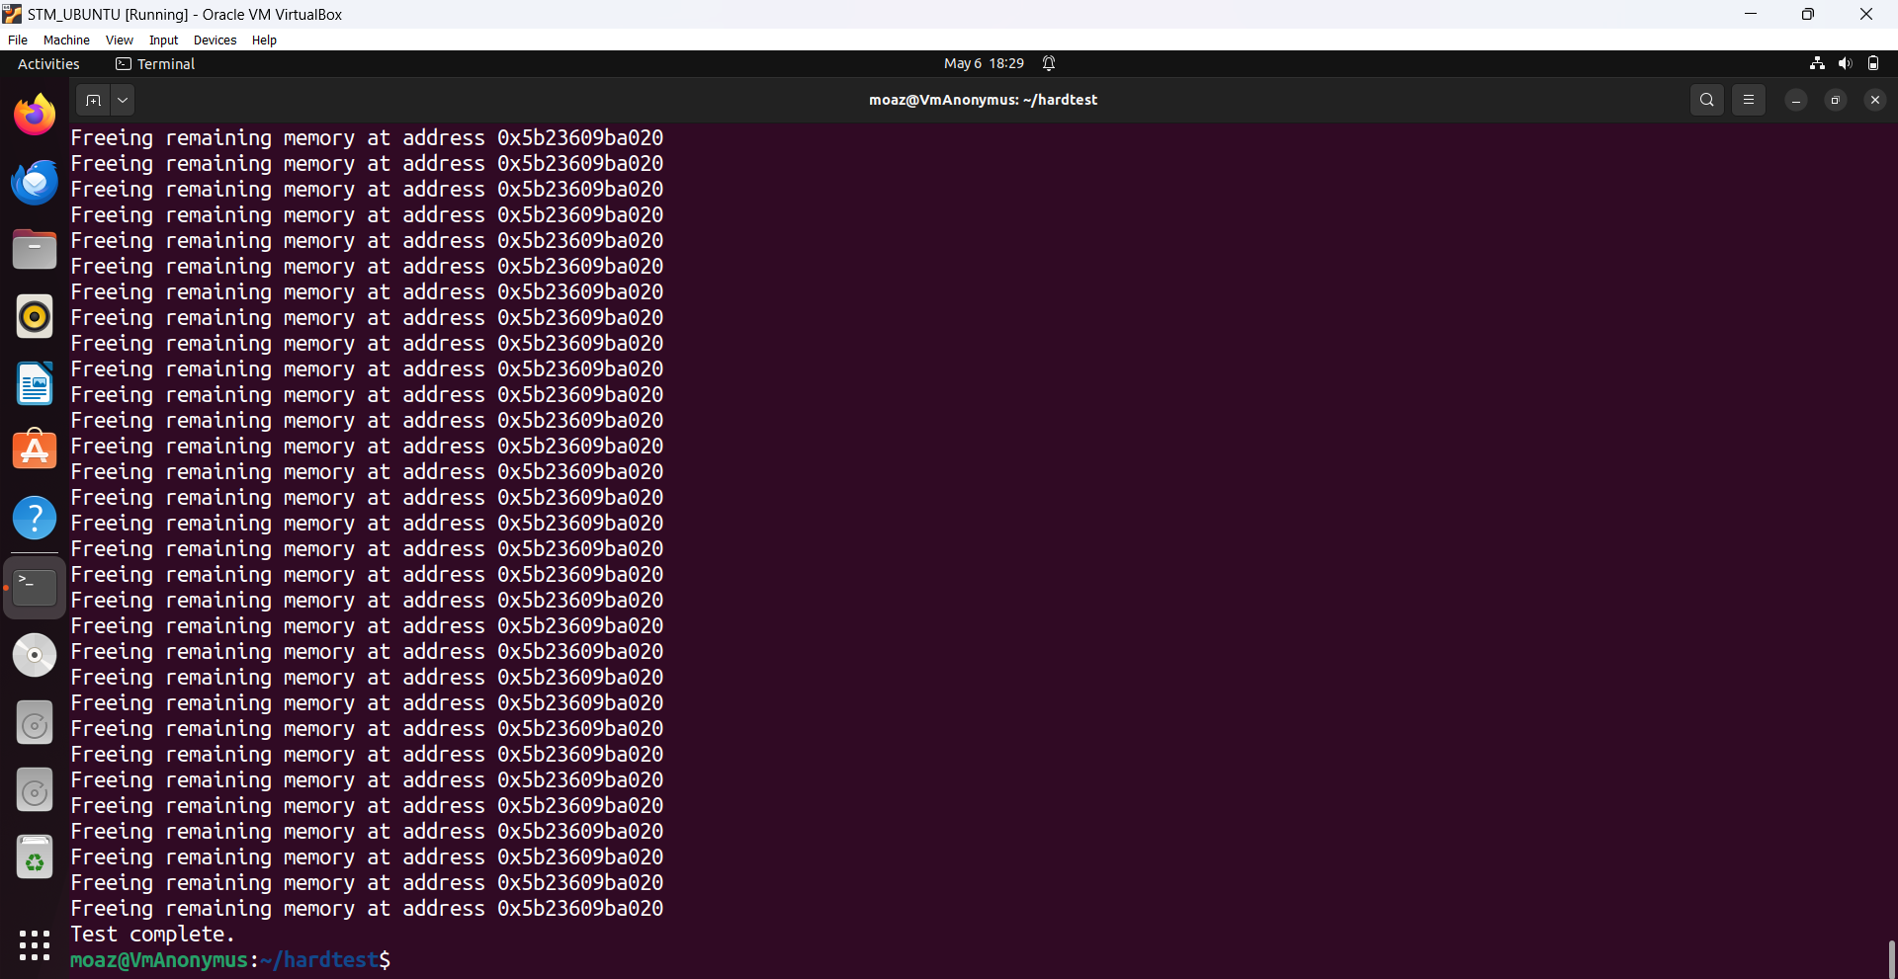
Randomize test

Slide 26
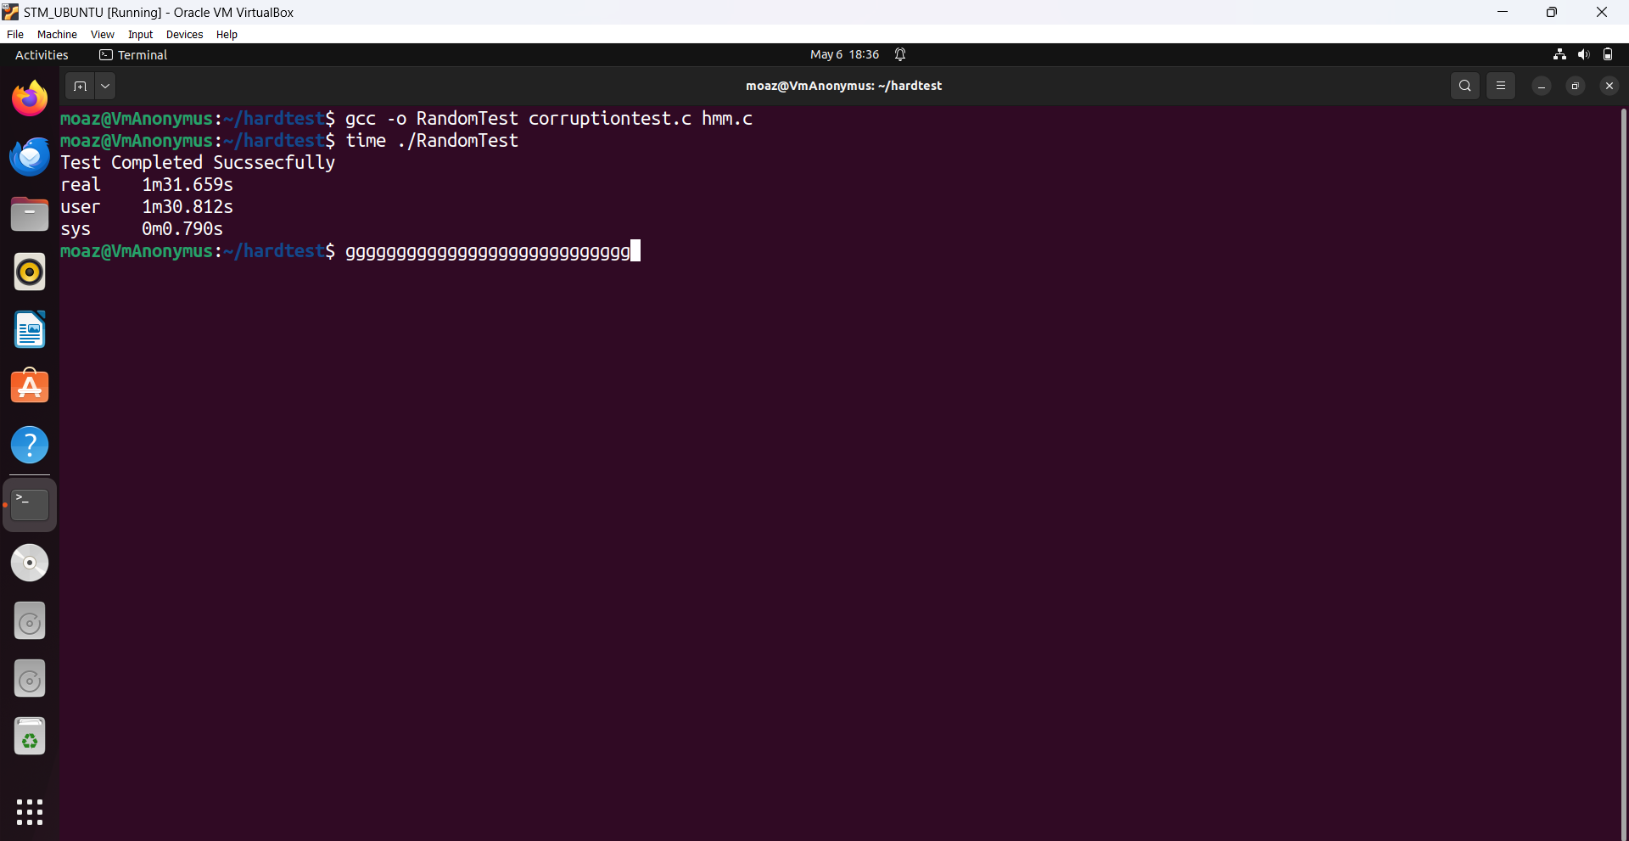
Another randomize test

Slide 27
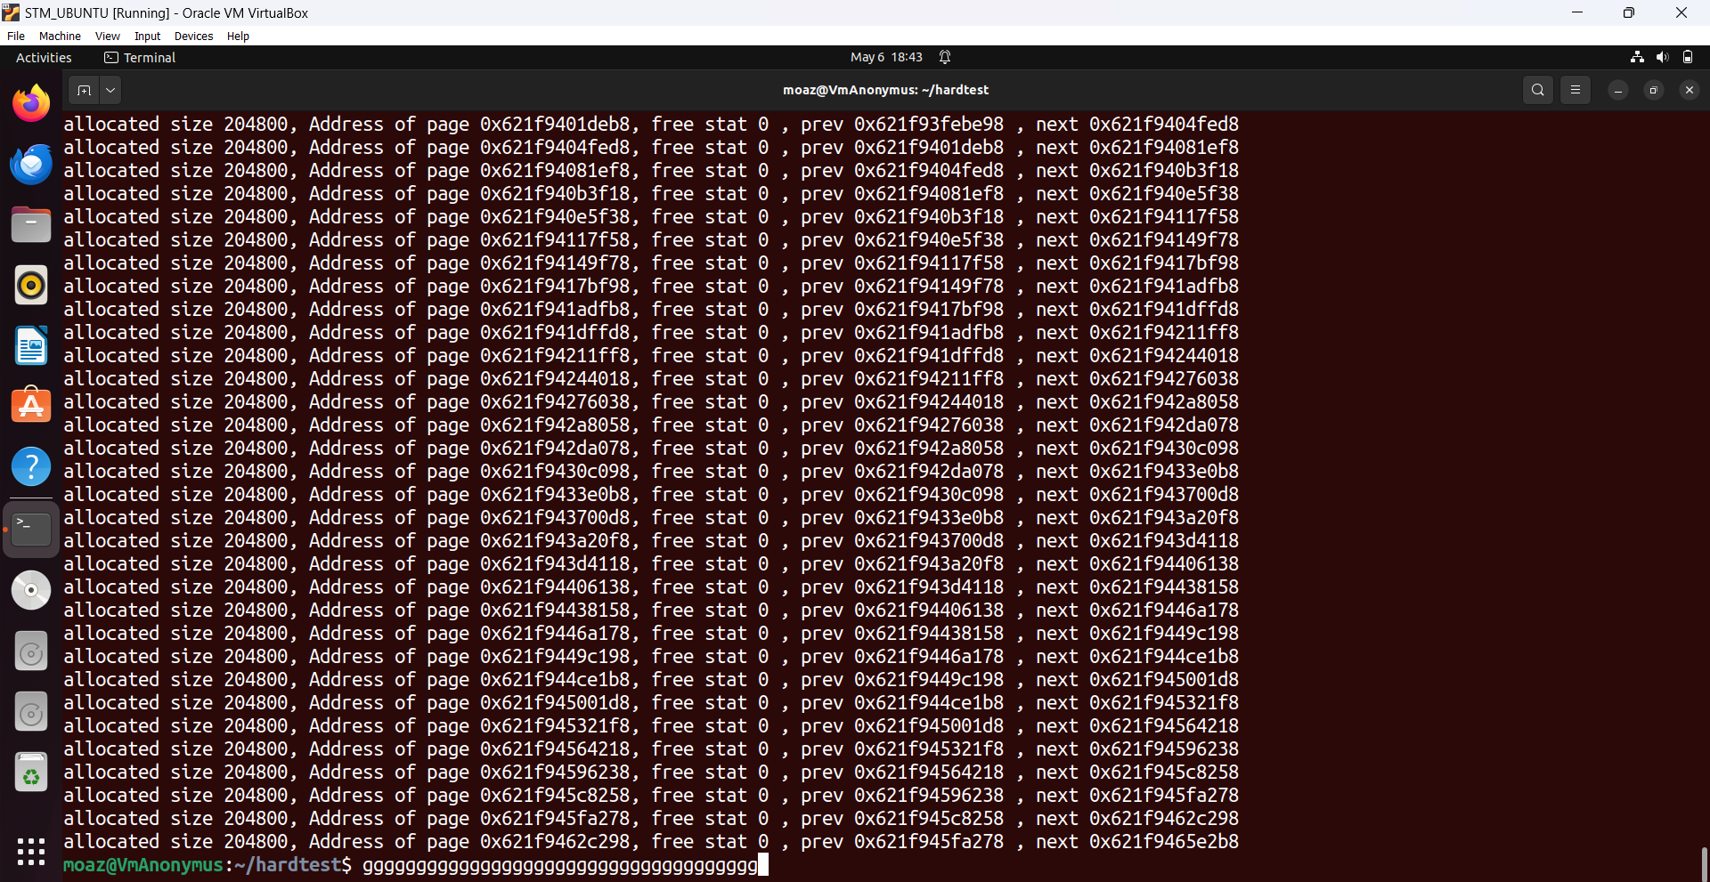
Manual Test

Slide 28
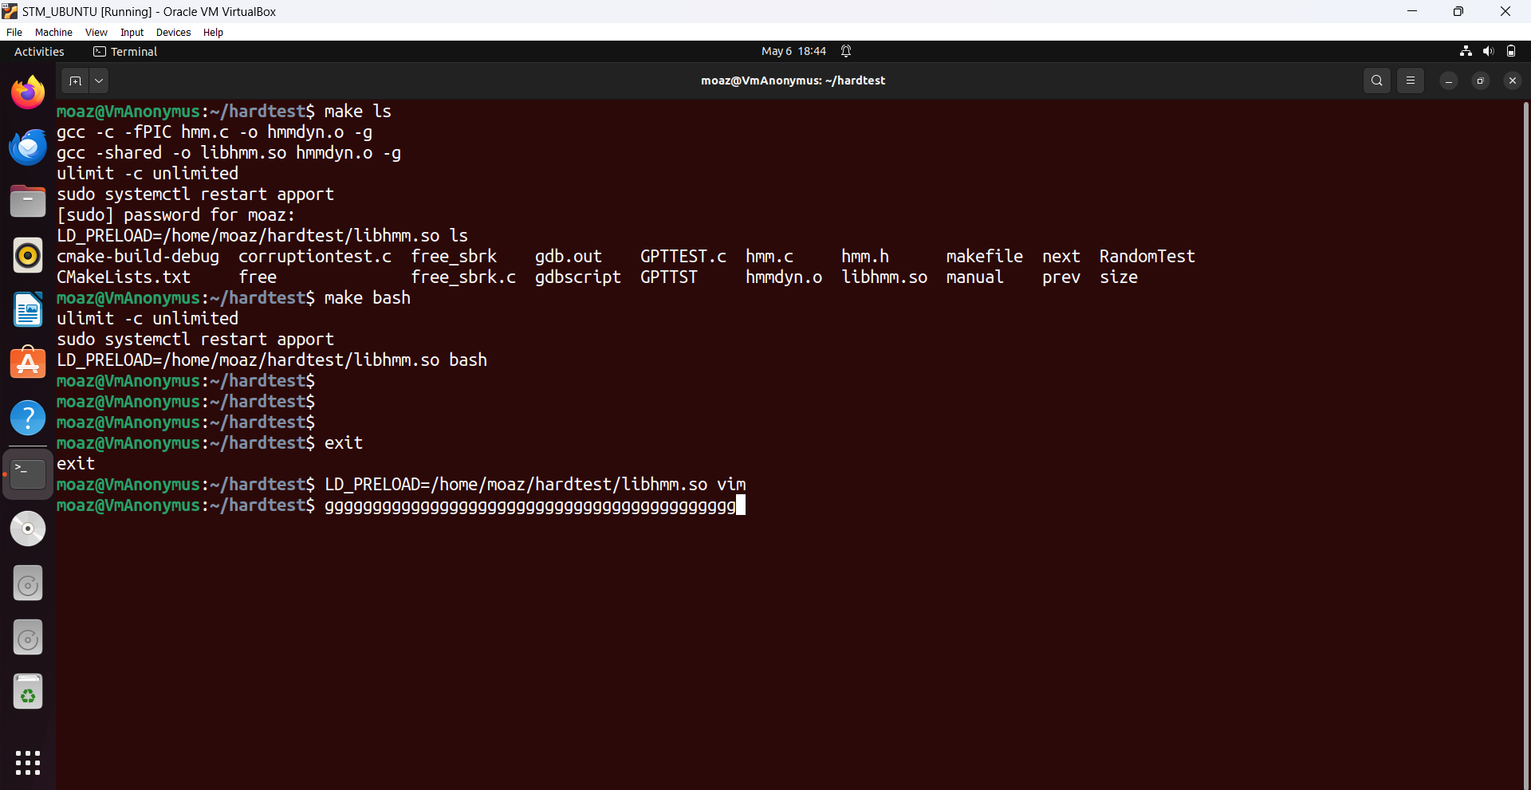
Linux utilities

Slide 29

Thank you
Many thanks to Eng Reda Maher
🫡🫡

